Slide 1
Data Mining: Concepts and Techniques Introduction Chapter 1
1
Notes:
1

Slide 2
Data Mining Tools & Technologies
Programming:
Python (scikit-learn, pandas, TensorFlow, Pytorch),
R, SQL.
- Big Data Platforms: Hadoop, Spark.
- Visualization Tools: Tableau, Power BI, matplotlib, seaborn, Plotly.

Slide 3
Data Mining Tools & Technologies
Dedicated Data Mining Software
Weka
Open-source Java-based tool.
Easy GUI with classification, clustering, association, and visualization.
Often used for teaching.
RapidMiner
Drag-and-drop GUI for workflows.
Supports classification, clustering, text mining, time-series.
Good for both academia & industry.
Orange
Visual programming + Python scripting.
Intuitive widgets for building pipelines.
Excellent for beginners.
KNIME
Similar to RapidMiner.
Strong at ETL (Extract, Transform, Load) and integration.

Slide 4
Chapter 1. Introduction
Why Data Mining?
What Is Data Mining?
A Multi-Dimensional View of Data Mining
What Kind of Data Can Be Mined?
What Kinds of Patterns Can Be Mined?
What Technology Are Used?
What Kind of Applications Are Targeted?
Major Issues in Data Mining
A Brief History of Data Mining and Data Mining Society
Summary

Slide 5
Why Data Mining?
The Explosive Growth of Data: from terabytes to petabytes
Data collection and data availability
Automated data collection tools, database systems, Web, computerized society
Major sources of abundant data
Business: Web, e-commerce, transactions, stocks, …
Science: Remote sensing, bioinformatics, scientific simulation, …
Society and everyone: news, digital cameras, YouTube
We are drowning in data, but starving for knowledge!
“Necessity is the mother of invention”—Data mining—Automated analysis of massive data sets

Slide 6
Evolution of Sciences
Before 1600, empirical science
1600-1950s, theoretical science
Each discipline has grown a theoretical component. Theoretical models often motivate experiments and generalize our understanding.
1950s-1990s, computational science
Over the last 50 years, most disciplines have grown a third, computational branch (e.g. empirical, theoretical, and computational ecology, or physics, or linguistics.)
Computational Science traditionally meant simulation. It grew out of our inability to find closed-form solutions for complex mathematical models.
1990-now, data science
The flood of data from new scientific instruments and simulations
The ability to economically store and manage petabytes of data online
The Internet and computing Grid that makes all these archives universally accessible
Scientific info. management, acquisition, organization, query, and visualization tasks scale almost linearly with data volumes. Data mining is a major new challenge!
Jim Gray and Alex Szalay, The World Wide Telescope: An Archetype for Online Science, Comm. ACM, 45(11): 50-54, Nov. 2002

Slide 7
Evolution of Database Technology
1960s:
Data collection, database creation, IMS and network DBMS
1970s:
Relational data model, relational DBMS implementation
1980s:
RDBMS, advanced data models (extended-relational, OO, deductive, etc.)
Application-oriented DBMS (spatial, scientific, engineering, etc.)
1990s:
Data mining, data warehousing, multimedia databases, and Web databases
2000s
Stream data management and mining
Data mining and its applications
Web technology (XML, data integration) and global information systems
Notes:
Two slides should be added after this one
1. Evolution of machine learning
2. Evolution of statistics methods

Slide 8
Why Data Mining?
Organizations today generate huge amounts of data:
Retail → customer purchase histories
Finance → credit card transactions
Healthcare → patient records & medical imaging
Social media → likes, shares, comments
Science → genomic data, sensor data, astronomy
Problem: Too much data, but little knowledge.
Solution: Data mining helps

Slide 9
Chapter 1. Introduction
Why Data Mining?
What Is Data Mining?
A Multi-Dimensional View of Data Mining
What Kind of Data Can Be Mined?
What Kinds of Patterns Can Be Mined?
What Technology Are Used?
What Kind of Applications Are Targeted?
Major Issues in Data Mining
A Brief History of Data Mining and Data Mining Society
Summary

Slide 10
What is Data Mining?
Data mining is the process of discovering meaningful patterns, trends, correlations, and knowledge from large volumes of data. It goes beyond simple statistics by using techniques from machine learning, artificial intelligence, and databases to extract hidden insights.

Slide 11
What Is Data Mining?
Data mining (knowledge discovery from data)
Extraction of interesting (non-trivial, implicit, previously unknown and potentially useful) patterns or knowledge from huge amount of data
Data mining: a misnomer?
Alternative names
Knowledge discovery (mining) in databases (KDD), knowledge extraction, data/pattern analysis, data archeology, data dredging, information harvesting, business intelligence, etc.
Watch out: Is everything “data mining”?
Simple search and query processing
(Deductive) expert systems

Slide 12
Data Mining vs Related Fields
Statistics → Focuses on inference & hypothesis testing.
Machine Learning → Focuses on prediction and algorithms.
Databases → Focuses on storing and retrieving large-scale data.
Data Mining → Integrates all three to extract actionable knowledge.

Slide 13
Knowledge Discovery (KDD) Process
Knowledge
This is a view from typical database systems and data warehousing communities
Data mining plays an essential role in the knowledge discovery process
Pattern Evaluation
Data Mining
Task-relevant Data
Data Warehouse
Selection
Data Cleaning
Data Integration
Databases

Slide 14
The Knowledge Discovery in Databases (KDD) Process
Data mining is part of a bigger cycle called KDD:
Data Cleaning → remove noise, handle missing values.
Data Integration → combine from multiple sources (databases, files, web).
Data Selection → choose relevant data.
Data Transformation → normalize, reduce dimensions, prepare for mining.
Data Mining → apply algorithms (classification, clustering, association rules).
Pattern Evaluation → identify truly interesting/novel patterns.
Knowledge Presentation → visualize results, dashboards, reports.

Slide 15
Example: A Web Mining Framework
Web mining usually involves
Data cleaning
Data integration from multiple sources
Warehousing the data
Data cube construction
Data selection for data mining
Data mining
Presentation of the mining results
Patterns and knowledge to be used or stored into knowledge-base

Slide 16
Data Mining in Business Intelligence
Increasing potential
to support
business decisions
End User
Decision Making
Data Presentation
Business
Analyst
Visualization Techniques
Data Mining
Data
Analyst
Information Discovery
Data Exploration
Statistical Summary, Querying, and Reporting
Data Preprocessing/Integration, Data Warehouses
Data Sources
DBA
Paper, Files, Web documents, Scientific experiments, Database Systems

Slide 17
Example: Mining vs. Data Exploration
Business intelligence view
Warehouse, data cube, reporting but not much mining
Business objects vs. data mining tools
Supply chain example: tools
Data presentation
Exploration

Slide 18
KDD Process: A Typical View from ML and Statistics
Pattern
Information
Knowledge
Input Data
Data Pre-Processing
Data Mining
Post-Processing
Data integration
Normalization
Feature selection
Dimension reduction
Pattern discovery
Association & correlation
Classification
Clustering
Outlier analysis
… … … …
Pattern evaluation
Pattern selection
Pattern interpretation
Pattern visualization
This is a view from typical machine learning and statistics communities

Slide 19
Example: Medical Data Mining
Health care & medical data mining – often adopted such a view in statistics and machine learning
Preprocessing of the data (including feature extraction and dimension reduction)
Classification or/and clustering processes
Post-processing for presentation

Slide 20
Chapter 1. Introduction
Why Data Mining?
What Is Data Mining?
A Multi-Dimensional View of Data Mining
What Kind of Data Can Be Mined?
What Kinds of Patterns Can Be Mined?
What Technology Are Used?
What Kind of Applications Are Targeted?
Major Issues in Data Mining
A Brief History of Data Mining and Data Mining Society
Summary

Slide 21
Multi-Dimensional View of Data Mining
Data to be mined
Database data (extended-relational, object-oriented, heterogeneous, legacy), data warehouse, transactional data, stream, spatiotemporal, time-series, sequence, text and web, multi-media, graphs & social and information networks
Knowledge to be mined (or: Data mining functions)
Characterization, discrimination, association, classification, clustering, trend/deviation, outlier analysis, etc.
Descriptive vs. predictive data mining
Multiple/integrated functions and mining at multiple levels
Techniques utilized
Data-intensive, data warehouse (OLAP), machine learning, statistics, pattern recognition, visualization, high-performance, etc.
Applications adapted
Retail, telecommunication, banking, fraud analysis, bio-data mining, stock market analysis, text mining, Web mining, etc.

Slide 22
Chapter 1. Introduction
Why Data Mining?
What Is Data Mining?
A Multi-Dimensional View of Data Mining
What Kind of Data Can Be Mined?
What Kinds of Patterns Can Be Mined?
What Technology Are Used?
What Kind of Applications Are Targeted?
Major Issues in Data Mining
A Brief History of Data Mining and Data Mining Society
Summary

Slide 23
Data Mining: On What Kinds of Data?
Database-oriented data sets and applications
Relational database, data warehouse, transactional database
Advanced data sets and advanced applications
Data streams and sensor data
Time-series data, temporal data, sequence data (incl. bio-sequences)
Structure data, graphs, social networks and multi-linked data
Object-relational databases
Heterogeneous databases and legacy databases
Spatial data and spatiotemporal data
Multimedia database
Text databases
The World-Wide Web

Slide 24
Chapter 1. Introduction
Why Data Mining?
What Is Data Mining?
A Multi-Dimensional View of Data Mining
What Kind of Data Can Be Mined?
What Kinds of Patterns Can Be Mined?
What Technology Are Used?
What Kind of Applications Are Targeted?
Major Issues in Data Mining
A Brief History of Data Mining and Data Mining Society
Summary

Slide 25
Data Mining Function: (1) Generalization
Information integration and data warehouse construction
Data cleaning, transformation, integration, and multidimensional data model
Data cube technology
Scalable methods for computing (i.e., materializing) multidimensional aggregates
OLAP (online analytical processing)
Multidimensional concept description: Characterization and discrimination
Generalize, summarize, and contrast data characteristics, e.g., dry vs. wet region
Notes:
I BELIEVE WE MAY NEED TO DO IT IN MORE IN-DEPTH INTRODUCTION, USING SOME EXAMPLES. So it will take one slide for one function, i.e., one chapter we want to cover. Do we need to cover chapter 2: preprocessing and 3. Statistical methods?

Slide 26
Data Mining Function: (2) Association and Correlation Analysis
Frequent patterns (or frequent itemsets)
What items are frequently purchased together in your Walmart?
Association, correlation vs. causality
A typical association rule
Diaper → Beer [0.5%, 75%] (support, confidence)
Are strongly associated items also strongly correlated?
How to mine such patterns and rules efficiently in large datasets?
How to use such patterns for classification, clustering, and other applications?

Slide 27
Data Mining Function: (3) Classification
Classification and label prediction
Construct models (functions) based on some training examples
Describe and distinguish classes or concepts for future prediction
E.g., classify countries based on (climate), or classify cars based on (gas mileage)
Predict some unknown class labels
Typical methods
Decision trees, naïve Bayesian classification, support vector machines, neural networks, rule-based classification, pattern-based classification, logistic regression, …
Typical applications:
Credit card fraud detection, direct marketing, classifying stars, diseases, web-pages, …

Slide 28
Data Mining Function: (4) Cluster Analysis
Unsupervised learning (i.e., Class label is unknown)
Group data to form new categories (i.e., clusters), e.g., cluster houses to find distribution patterns
Principle: Maximizing intra-class similarity & minimizing interclass similarity
Many methods and applications

Slide 29
Data Mining Function: (5) Outlier Analysis
Outlier analysis
Outlier: A data object that does not comply with the general behavior of the data
Noise or exception? ― One person’s garbage could be another person’s treasure
Methods: by product of clustering or regression analysis, …
Useful in fraud detection, rare events analysis

Slide 30
Time and Ordering: Sequential Pattern, Trend and Evolution Analysis
Sequence, trend and evolution analysis
Trend, time-series, and deviation analysis: e.g., regression and value prediction
Sequential pattern mining
e.g., first buy digital camera, then buy large SD memory cards
Periodicity analysis
Motifs and biological sequence analysis
Approximate and consecutive motifs
Similarity-based analysis
Mining data streams
Ordered, time-varying, potentially infinite, data streams

Slide 31
Structure and Network Analysis
Graph mining
Finding frequent subgraphs (e.g., chemical compounds), trees (XML), substructures (web fragments)
Information network analysis
Social networks: actors (objects, nodes) and relationships (edges)
e.g., author networks in CS, terrorist networks
Multiple heterogeneous networks
A person could be multiple information networks: friends, family, classmates, …
Links carry a lot of semantic information: Link mining
Web mining
Web is a big information network: from PageRank to Google
Analysis of Web information networks
Web community discovery, opinion mining, usage mining, …
Notes:
This chapter will not be in the new version, will it?
BUT SHOULD WESTILL INTRODCE THEM SO THAT THEY WILL GET AN OVERALL PICTURE?

Slide 32
Evaluation of Knowledge
Are all mined knowledge interesting?
One can mine tremendous amount of “patterns” and knowledge
Some may fit only certain dimension space (time, location, …)
Some may not be representative, may be transient, …
Evaluation of mined knowledge → directly mine only interesting knowledge?
Descriptive vs. predictive
Coverage
Typicality vs. novelty
Accuracy
Timeliness
…

Slide 33
Chapter 1. Introduction
Why Data Mining?
What Is Data Mining?
A Multi-Dimensional View of Data Mining
What Kind of Data Can Be Mined?
What Kinds of Patterns Can Be Mined?
What Technology Are Used?
What Kind of Applications Are Targeted?
Major Issues in Data Mining
A Brief History of Data Mining and Data Mining Society
Summary

Slide 34
Data Mining: Confluence of Multiple Disciplines
Machine
Learning
Pattern
Recognition
Statistics
Applications
Data Mining
Visualization
Algorithm
Database
Technology
High-Performance
Computing

Slide 35
Why Confluence of Multiple Disciplines?
Tremendous amount of data
Algorithms must be highly scalable to handle such as tera-bytes of data
High-dimensionality of data
Micro-array may have tens of thousands of dimensions
High complexity of data
Data streams and sensor data
Time-series data, temporal data, sequence data
Structure data, graphs, social networks and multi-linked data
Heterogeneous databases and legacy databases
Spatial, spatiotemporal, multimedia, text and Web data
Software programs, scientific simulations
New and sophisticated applications
Notes:
Add a definition/description of “traditional data analysis”.

Slide 36
Chapter 1. Introduction
Why Data Mining?
What Is Data Mining?
A Multi-Dimensional View of Data Mining
What Kind of Data Can Be Mined?
What Kinds of Patterns Can Be Mined?
What Technology Are Used?
What Kind of Applications Are Targeted?
Major Issues in Data Mining
A Brief History of Data Mining and Data Mining Society
Summary

Slide 37
Applications of Data Mining
Web page analysis: from web page classification, clustering to PageRank & HITS algorithms
Collaborative analysis & recommender systems
Basket data analysis to targeted marketing
Biological and medical data analysis: classification, cluster analysis (microarray data analysis), biological sequence analysis, biological network analysis
Data mining and software engineering (e.g., IEEE Computer, Aug. 2009 issue)
From major dedicated data mining systems/tools (e.g., SAS, MS SQL-Server Analysis Manager, Oracle Data Mining Tools) to invisible data mining

Slide 38
Chapter 1. Introduction
Why Data Mining?
What Is Data Mining?
A Multi-Dimensional View of Data Mining
What Kind of Data Can Be Mined?
What Kinds of Patterns Can Be Mined?
What Technology Are Used?
What Kind of Applications Are Targeted?
Major Issues in Data Mining
A Brief History of Data Mining and Data Mining Society
Summary

Slide 39
Major Issues in Data Mining (1)
Mining Methodology
Mining various and new kinds of knowledge
Mining knowledge in multi-dimensional space
Data mining: An interdisciplinary effort
Boosting the power of discovery in a networked environment
Handling noise, uncertainty, and incompleteness of data
Pattern evaluation and pattern- or constraint-guided mining
User Interaction
Interactive mining
Incorporation of background knowledge
Presentation and visualization of data mining results

Slide 40
Major Issues in Data Mining (2)
Efficiency and Scalability
Efficiency and scalability of data mining algorithms
Parallel, distributed, stream, and incremental mining methods
Diversity of data types
Handling complex types of data
Mining dynamic, networked, and global data repositories
Data mining and society
Social impacts of data mining
Privacy-preserving data mining
Invisible data mining

Slide 41
Chapter 1. Introduction
Why Data Mining?
What Is Data Mining?
A Multi-Dimensional View of Data Mining
What Kind of Data Can Be Mined?
What Kinds of Patterns Can Be Mined?
What Technology Are Used?
What Kind of Applications Are Targeted?
Major Issues in Data Mining
A Brief History of Data Mining and Data Mining Society
Summary

Slide 42
A Brief History of Data Mining Society
1989 IJCAI Workshop on Knowledge Discovery in Databases
Knowledge Discovery in Databases (G. Piatetsky-Shapiro and W. Frawley, 1991)
1991-1994 Workshops on Knowledge Discovery in Databases
Advances in Knowledge Discovery and Data Mining (U. Fayyad, G. Piatetsky-Shapiro, P. Smyth, and R. Uthurusamy, 1996)
1995-1998 International Conferences on Knowledge Discovery in Databases and Data Mining (KDD’95-98)
Journal of Data Mining and Knowledge Discovery (1997)
ACM SIGKDD conferences since 1998 and SIGKDD Explorations
More conferences on data mining
PAKDD (1997), PKDD (1997), SIAM-Data Mining (2001), (IEEE) ICDM (2001), etc.
ACM Transactions on KDD starting in 2007

Slide 43
Conferences and Journals on Data Mining
KDD Conferences
ACM SIGKDD Int. Conf. on Knowledge Discovery in Databases and Data Mining (KDD)
SIAM Data Mining Conf. (SDM)
(IEEE) Int. Conf. on Data Mining (ICDM)
European Conf. on Machine Learning and Principles and practices of Knowledge Discovery and Data Mining (ECML-PKDD)
Pacific-Asia Conf. on Knowledge Discovery and Data Mining (PAKDD)
Int. Conf. on Web Search and Data Mining (WSDM)
Other related conferences
DB conferences: ACM SIGMOD, VLDB, ICDE, EDBT, ICDT, …
Web and IR conferences: WWW, SIGIR, WSDM
ML conferences: ICML, NIPS
PR conferences: CVPR,
Journals
Data Mining and Knowledge Discovery (DAMI or DMKD)
IEEE Trans. On Knowledge and Data Eng. (TKDE)
KDD Explorations
ACM Trans. on KDD

Slide 44
Where to Find References? DBLP, CiteSeer, Google
Data mining and KDD (SIGKDD: CDROM)
Conferences: ACM-SIGKDD, IEEE-ICDM, SIAM-DM, PKDD, PAKDD, etc.
Journal: Data Mining and Knowledge Discovery, KDD Explorations, ACM TKDD
Database systems (SIGMOD: ACM SIGMOD Anthology—CD ROM)
Conferences: ACM-SIGMOD, ACM-PODS, VLDB, IEEE-ICDE, EDBT, ICDT, DASFAA
Journals: IEEE-TKDE, ACM-TODS/TOIS, JIIS, J. ACM, VLDB J., Info. Sys., etc.
AI & Machine Learning
Conferences: Machine learning (ML), AAAI, IJCAI, COLT (Learning Theory), CVPR, NIPS, etc.
Journals: Machine Learning, Artificial Intelligence, Knowledge and Information Systems, IEEE-PAMI, etc.
Web and IR
Conferences: SIGIR, WWW, CIKM, etc.
Journals: WWW: Internet and Web Information Systems,
Statistics
Conferences: Joint Stat. Meeting, etc.
Journals: Annals of statistics, etc.
Visualization
Conference proceedings: CHI, ACM-SIGGraph, etc.
Journals: IEEE Trans. visualization and computer graphics, etc.

Slide 45
Chapter 1. Introduction
Why Data Mining?
What Is Data Mining?
A Multi-Dimensional View of Data Mining
What Kind of Data Can Be Mined?
What Kinds of Patterns Can Be Mined?
What Technology Are Used?
What Kind of Applications Are Targeted?
Major Issues in Data Mining
A Brief History of Data Mining and Data Mining Society
Summary

Slide 46
Summary
Data mining: Discovering interesting patterns and knowledge from massive amount of data
A natural evolution of database technology, in great demand, with wide applications
A KDD process includes data cleaning, data integration, data selection, transformation, data mining, pattern evaluation, and knowledge presentation
Mining can be performed in a variety of data
Data mining functionalities: characterization, discrimination, association, classification, clustering, outlier and trend analysis, etc.
Data mining technologies and applications
Major issues in data mining

Slide 47
Recommended Reference Books
S. Chakrabarti. Mining the Web: Statistical Analysis of Hypertex and Semi-Structured Data. Morgan Kaufmann, 2002
R. O. Duda, P. E. Hart, and D. G. Stork, Pattern Classification, 2ed., Wiley-Interscience, 2000
T. Dasu and T. Johnson. Exploratory Data Mining and Data Cleaning. John Wiley & Sons, 2003
U. M. Fayyad, G. Piatetsky-Shapiro, P. Smyth, and R. Uthurusamy. Advances in Knowledge Discovery and Data Mining. AAAI/MIT Press, 1996
U. Fayyad, G. Grinstein, and A. Wierse, Information Visualization in Data Mining and Knowledge Discovery, Morgan Kaufmann, 2001
J. Han and M. Kamber. Data Mining: Concepts and Techniques. Morgan Kaufmann, 3rd ed., 2011
D. J. Hand, H. Mannila, and P. Smyth, Principles of Data Mining, MIT Press, 2001
T. Hastie, R. Tibshirani, and J. Friedman, The Elements of Statistical Learning: Data Mining, Inference, and Prediction, 2nd ed., Springer-Verlag, 2009
B. Liu, Web Data Mining, Springer 2006.
T. M. Mitchell, Machine Learning, McGraw Hill, 1997
G. Piatetsky-Shapiro and W. J. Frawley. Knowledge Discovery in Databases. AAAI/MIT Press, 1991
P.-N. Tan, M. Steinbach and V. Kumar, Introduction to Data Mining, Wiley, 2005
S. M. Weiss and N. Indurkhya, Predictive Data Mining, Morgan Kaufmann, 1998
I. H. Witten and E. Frank, Data Mining: Practical Machine Learning Tools and Techniques with Java Implementations, Morgan Kaufmann, 2nd ed. 2005

Slide 48


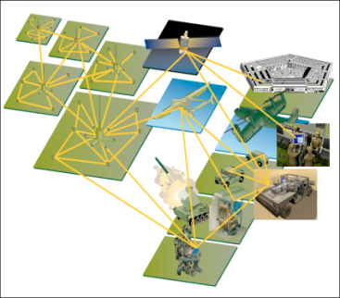
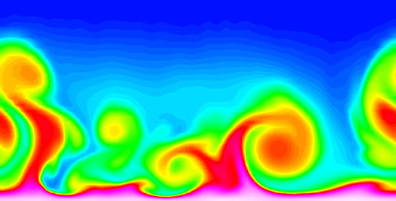
Large-scale Data is Everywhere!
There has been enormous data growth in both commercial and scientific databases due to advances in data generation and collection technologies
New mantra
Gather whatever data you can whenever and wherever possible.
Expectations
Gathered data will have value either for the purpose collected or for a purpose not envisioned.
E-Commerce
Cyber Security
Traffic Patterns
Social Networking: Twitter
Sensor Networks
Computational Simulations
Notes:
48

Slide 49




Why Data Mining? Commercial Viewpoint
Lots of data is being collected and warehoused
Web data
Google has Peta Bytes of web data
Facebook has billions of active users
purchases at department/ grocery stores, e-commerce
Amazon handles millions of visits/day
Bank/Credit Card transactions
Computers have become cheaper and more powerful
Competitive Pressure is Strong
Provide better, customized services for an edge (e.g. in Customer Relationship Management)
Notes:
49

Slide 50
Why Data Mining? Scientific Viewpoint
Data collected and stored at enormous speeds
remote sensors on a satellite
NASA EOSDIS archives over petabytes of earth science data / year
telescopes scanning the skies
Sky survey data
High-throughput biological data
scientific simulations
terabytes of data generated in a few hours
Data mining helps scientists
in automated analysis of massive datasets
In hypothesis formation
fMRI Data from Brain
Sky Survey Data
Gene Expression Data
Surface Temperature of Earth
Notes:
50

Slide 51
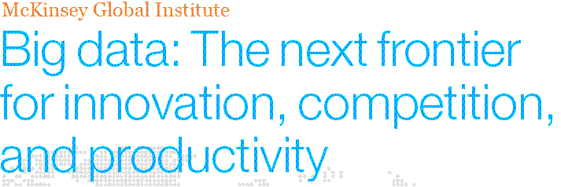
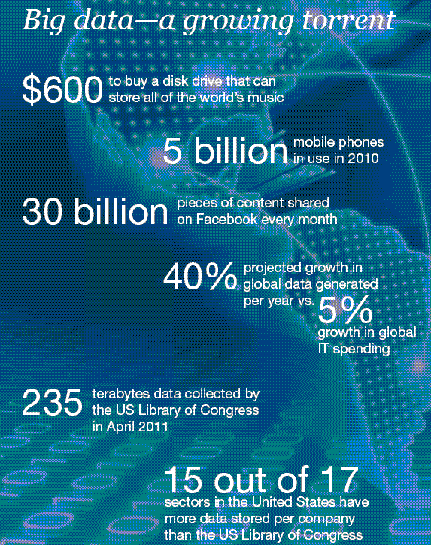
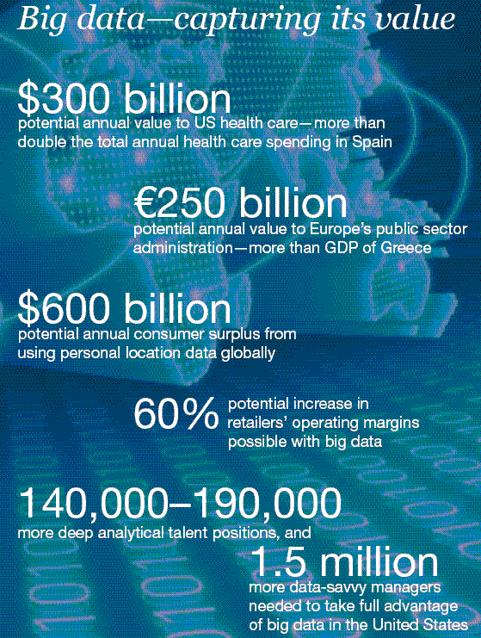
Great opportunities to improve productivity in all walks of life

Slide 52

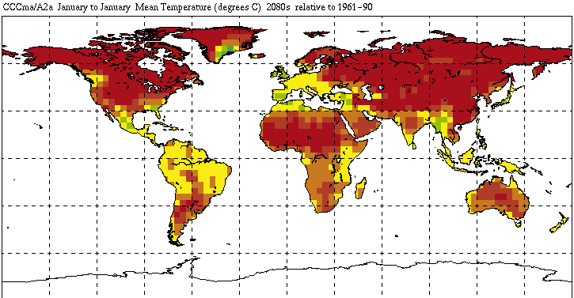


Great Opportunities to Solve Society’s Major Problems
Improving health care and reducing costs
Predicting the impact of climate change
Finding alternative/ green energy sources
Reducing hunger and poverty by
increasing agriculture production

Slide 53
What is Data Mining?
Many Definitions
Non-trivial extraction of implicit, previously unknown and potentially useful information from data
Exploration & analysis, by automatic or semi-automatic means, of large quantities of data in order to discover meaningful patterns

Slide 54
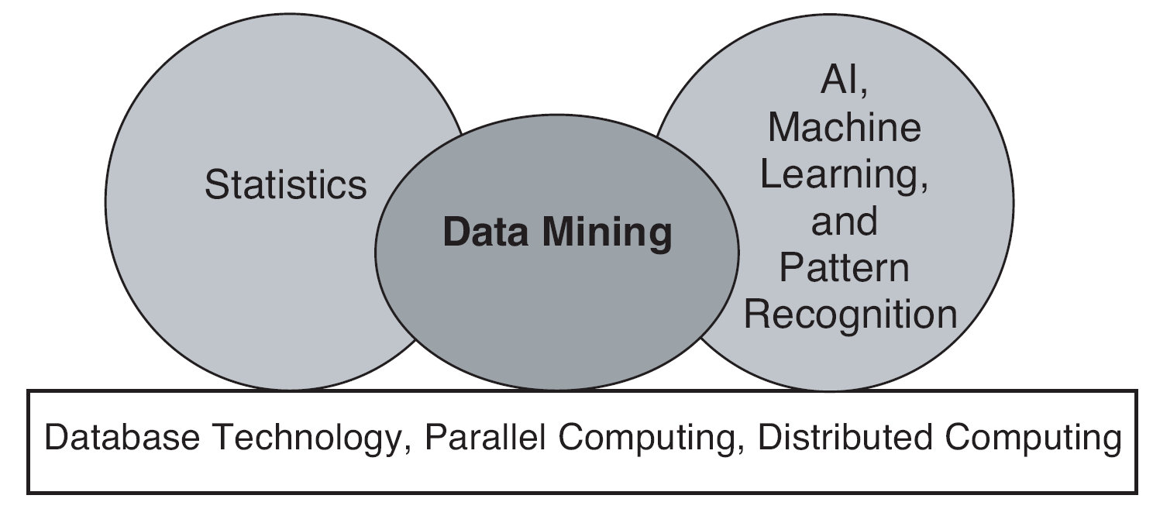
Origins of Data Mining
Draws ideas from machine learning/AI, pattern recognition, statistics, and database systems
Traditional techniques may be unsuitable due to data that is
Large-scale
High dimensional
Heterogeneous
Complex
Distributed
A key component of the emerging field of data science and data-driven discovery

Slide 55
Data Mining Tasks
Prediction Methods
Use some variables to predict unknown or future values of other variables.
Description Methods
Find human-interpretable patterns that describe the data.
From [Fayyad, et.al.] Advances in Knowledge Discovery and Data Mining, 1996

Slide 56
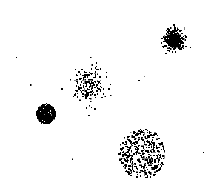

Data Mining Tasks …
Data
Clustering
Predictive Modeling
Association Rules
Anomaly Detection
Milk

Slide 57
Predictive Modeling: Classification
Find a model for class attribute as a function of the values of other attributes
Model for predicting credit worthiness
Class

Slide 58
Classification Example
categorical
categorical
quantitative
class
Test
Set
Learn
Classifier
Training
Set
Model

Slide 59
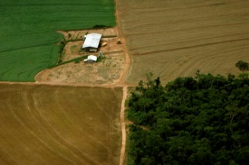
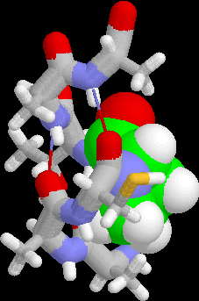
Examples of Classification Task
Classifying credit card transactions as legitimate or fraudulent
Classifying land covers (water bodies, urban areas, forests, etc.) using satellite data
Categorizing news stories as finance, weather, entertainment, sports, etc
Identifying intruders in the cyberspace
Predicting tumor cells as benign or malignant
Classifying secondary structures of protein as alpha-helix, beta-sheet, or random coil

Slide 60
Classification: Application 1
Fraud Detection
Goal: Predict fraudulent cases in credit card transactions.
Approach:
Use credit card transactions and the information on its account-holder as attributes.
When does a customer buy, what does he buy, how often he pays on time, etc
Label past transactions as fraud or fair transactions. This forms the class attribute.
Learn a model for the class of the transactions.
Use this model to detect fraud by observing credit card transactions on an account.

Slide 61
Classification: Application 2
Churn prediction for telephone customers
Goal: To predict whether a customer is likely to be lost to a competitor.
Approach:
Use detailed record of transactions with each of the past and present customers, to find attributes.
How often the customer calls, where he calls, what time-of-the day he calls most, his financial status, marital status, etc.
Label the customers as loyal or disloyal.
Find a model for loyalty.
From [Berry & Linoff] Data Mining Techniques, 1997

Slide 62
Classification: Application 3
Sky Survey Cataloging
Goal: To predict class (star or galaxy) of sky objects, especially visually faint ones, based on the telescopic survey images (from Palomar Observatory).
3000 images with 23,040 x 23,040 pixels per image.
Approach:
Segment the image.
Measure image attributes (features) - 40 of them per object.
Model the class based on these features.
Success Story: Could find 16 new high red-shift quasars, some of the farthest objects that are difficult to find!
From [Fayyad, et.al.] Advances in Knowledge Discovery and Data Mining, 1996

Slide 63
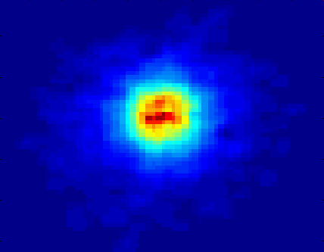
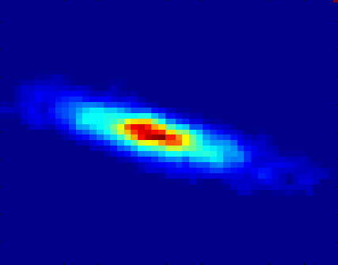
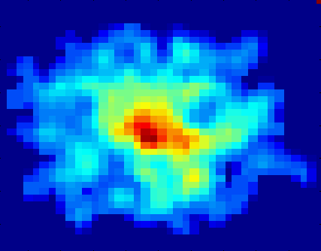
Classifying Galaxies
Courtesy: http://aps.umn.edu
Early
Class:
Stages of Formation
Attributes:
Image features,
Characteristics of light waves received, etc.
Intermediate
Late
Data Size:
72 million stars, 20 million galaxies
Object Catalog: 9 GB
Image Database: 150 GB

Slide 64
Regression
Predict a value of a given continuous valued variable based on the values of other variables, assuming a linear or nonlinear model of dependency.
Extensively studied in statistics, neural network fields.
Examples:
Predicting sales amounts of new product based on advetising expenditure.
Predicting wind velocities as a function of temperature, humidity, air pressure, etc.
Time series prediction of stock market indices.

Slide 65
Clustering
Finding groups of objects such that the objects in a group will be similar (or related) to one another and different from (or unrelated to) the objects in other groups
Inter-cluster distances are maximized
Intra-cluster distances are minimized

Slide 66
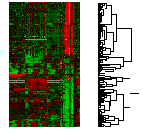
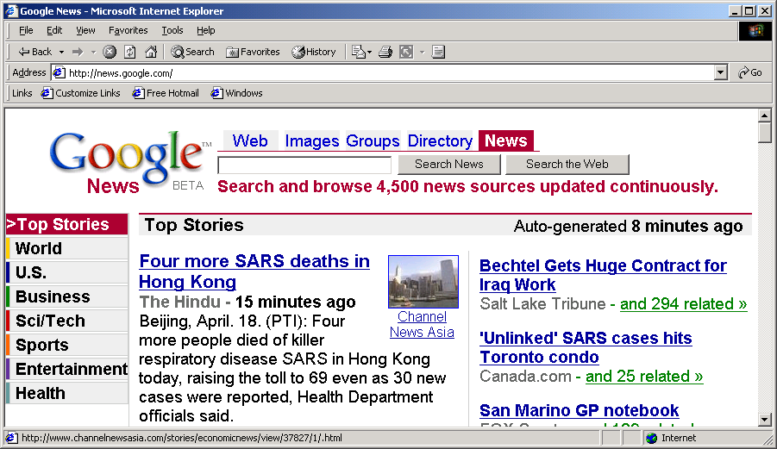
Applications of Cluster Analysis
Understanding
Custom profiling for targeted marketing
Group related documents for browsing
Group genes and proteins that have similar functionality
Group stocks with similar price fluctuations
Summarization
Reduce the size of large data sets
Courtesy: Michael Eisen
Use of K-means to partition Sea Surface Temperature (SST) and Net Primary Production (NPP) into clusters that reflect the Northern and Southern Hemispheres.

Slide 67
Clustering: Application 1
Market Segmentation:
Goal: subdivide a market into distinct subsets of customers where any subset may conceivably be selected as a market target to be reached with a distinct marketing mix.
Approach:
Collect different attributes of customers based on their geographical and lifestyle related information.
Find clusters of similar customers.
Measure the clustering quality by observing buying patterns of customers in same cluster vs. those from different clusters.

Slide 68
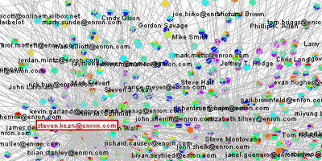
Clustering: Application 2
Document Clustering:
Goal: To find groups of documents that are similar to each other based on the important terms appearing in them.
Approach: To identify frequently occurring terms in each document. Form a similarity measure based on the frequencies of different terms. Use it to cluster.
Enron email dataset

Slide 69
Association Rule Discovery: Definition
Given a set of records each of which contain some number of items from a given collection
Produce dependency rules which will predict occurrence of an item based on occurrences of other items.
Rules Discovered:
{Milk} --> {Coke}
{Diaper, Milk} --> {Beer}

Slide 70
Association Analysis: Applications
Market-basket analysis
Rules are used for sales promotion, shelf management, and inventory management
Telecommunication alarm diagnosis
Rules are used to find combination of alarms that occur together frequently in the same time period
Medical Informatics
Rules are used to find combination of patient symptoms and test results associated with certain diseases

Slide 71
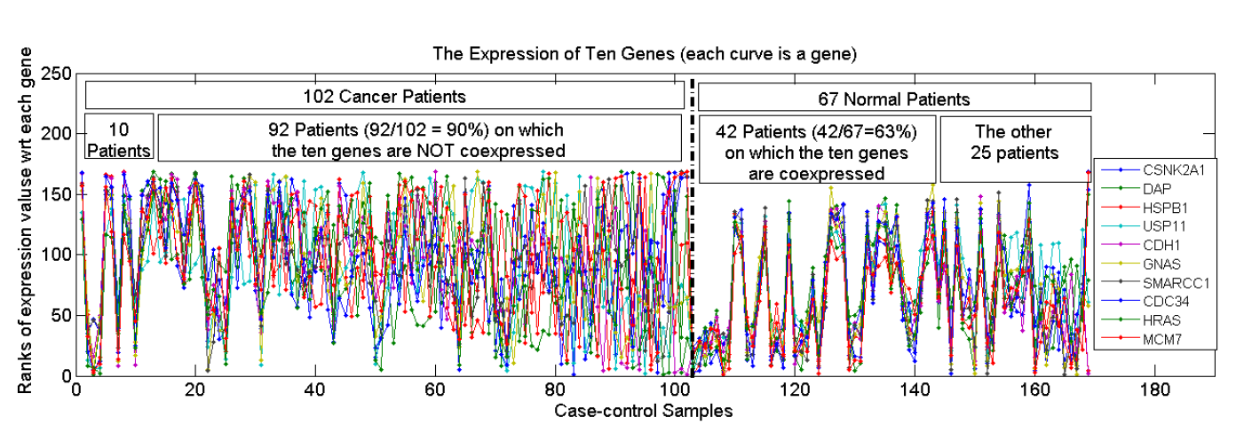
Association Analysis: Applications
An Example Subspace Differential Coexpression Pattern from lung cancer dataset
Enriched with the TNF/NFB signaling pathway
which is well-known to be related to lung cancer
P-value: 1.4*10⁻⁵ (6/10 overlap with the pathway)
Three lung cancer datasets [Bhattacharjee et al. 2001], [Stearman et al. 2005], [Su et al. 2007]
[Fang et al PSB 2010]

Slide 72
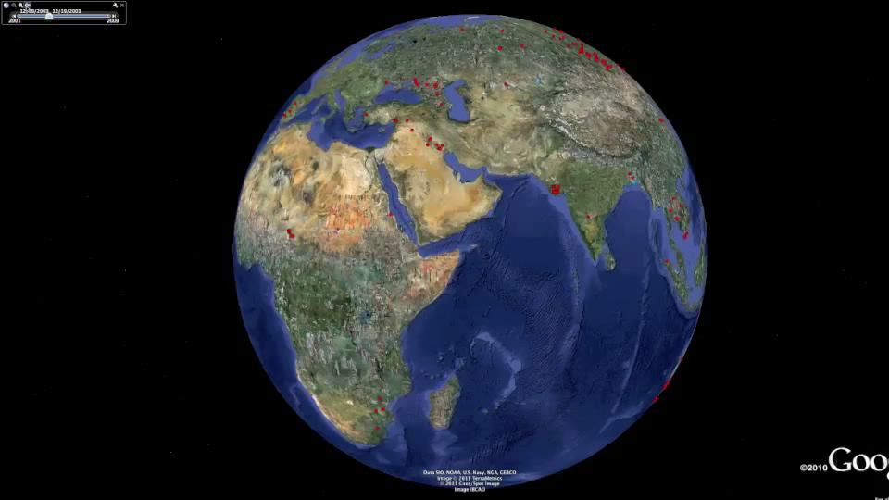
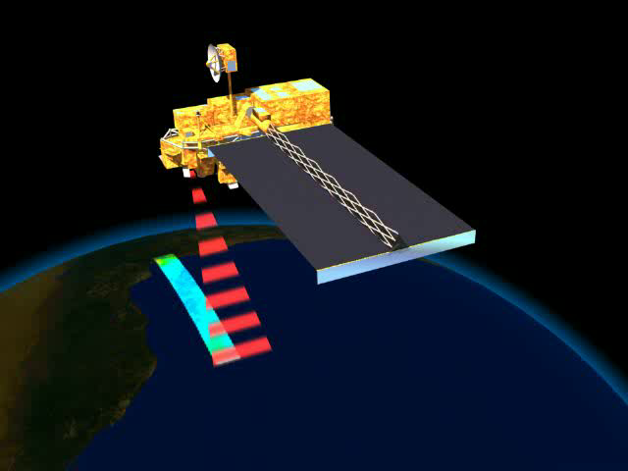
Deviation/Anomaly/Change Detection
Detect significant deviations from normal behavior
Applications:
Credit Card Fraud Detection
Network Intrusion Detection
Identify anomalous behavior from sensor networks for monitoring and surveillance.
Detecting changes in the global forest cover.

Slide 73
Motivating Challenges
Scalability
High Dimensionality
Heterogeneous and Complex Data
Data Ownership and Distribution
Non-traditional Analysis

Slide 74
Thanks
Any questions

